Slide 1

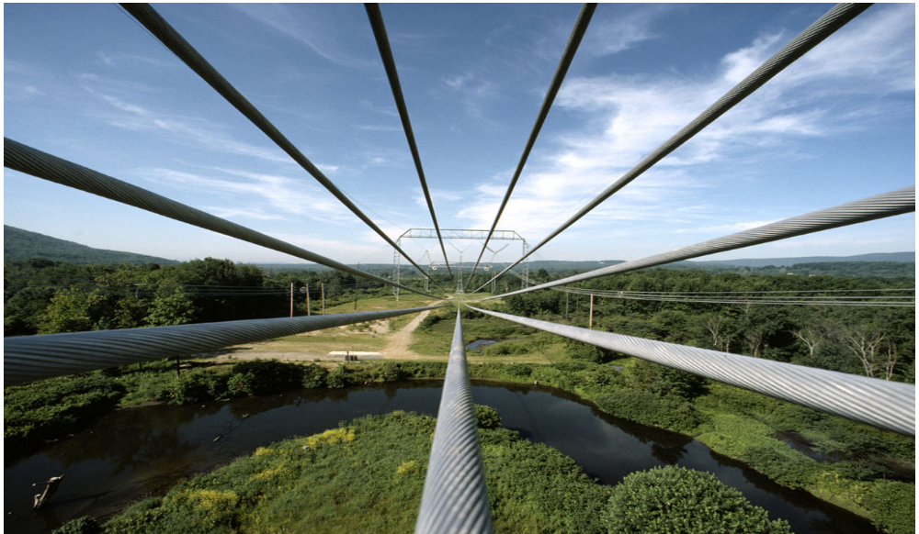
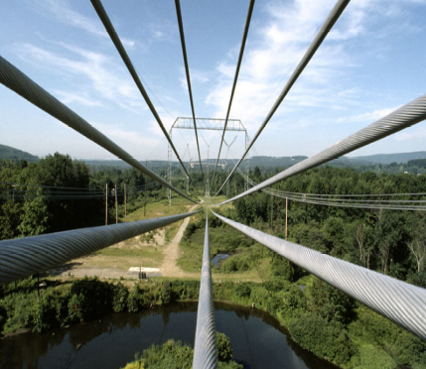
Chapter 3
Work and Energy

Slide 2
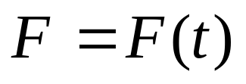
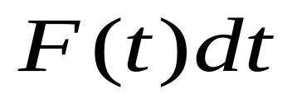

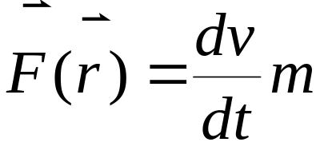
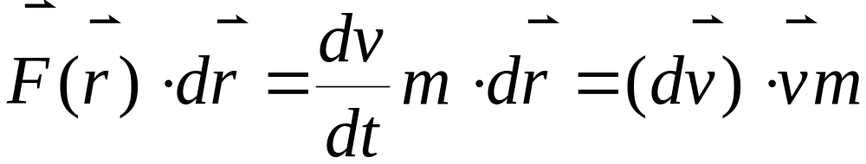

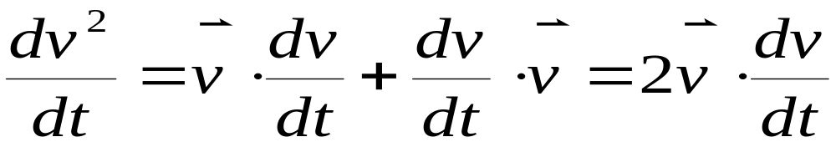

§1. Work

transport momentum .
What does F transport?
transport energy.

covariant under Galileao’s
Transformation.

Slide 3
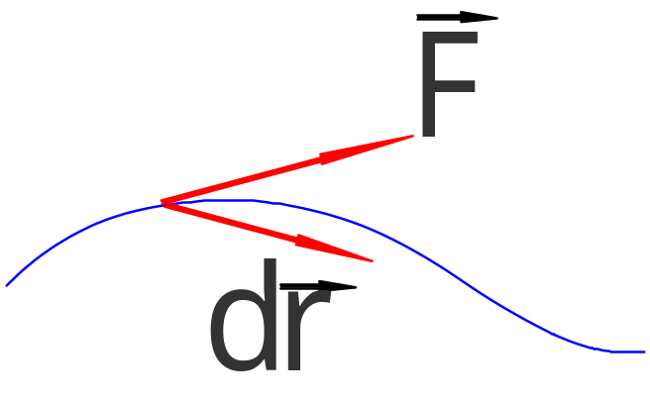
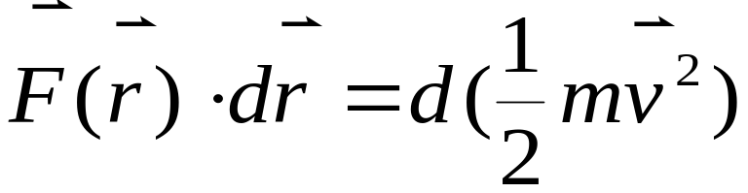
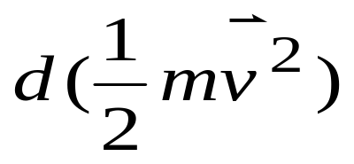
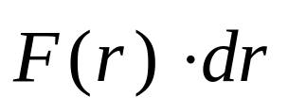
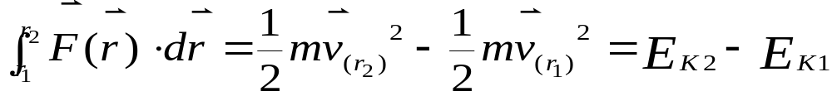

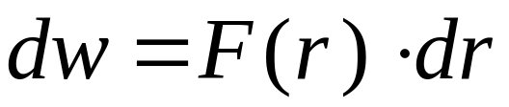

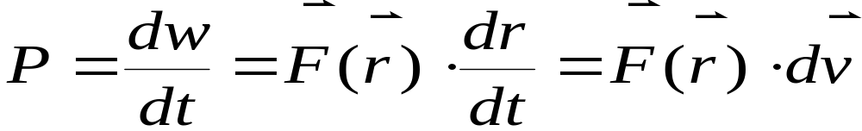

Theorem of Kinetic energy:
⇒
Work
Kinetic Energy
Definition of work:

But not Why?
related to energy,momentum
Power:

Slide 4
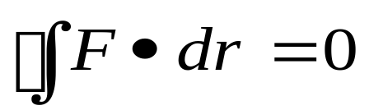
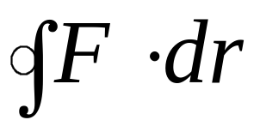
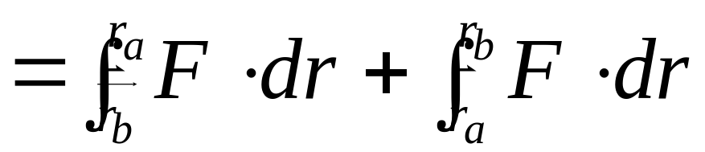
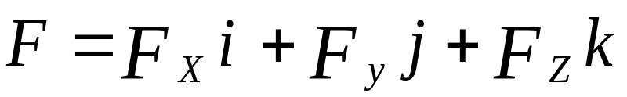
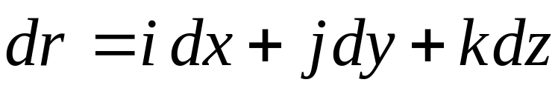
§2.Law of conservation of mechanical energy
2-1. Conservative force
Conservative force
Work done is
independent of path.

Non conservative force
Uniform force,Gravity, Elastic force:
Example:
(1).Work done by a uniform force.
(I)
(II)

Slide 5
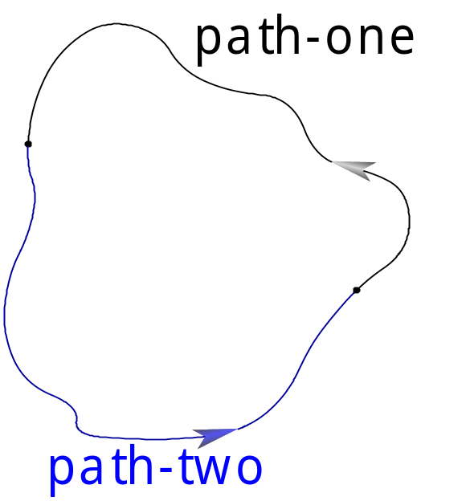
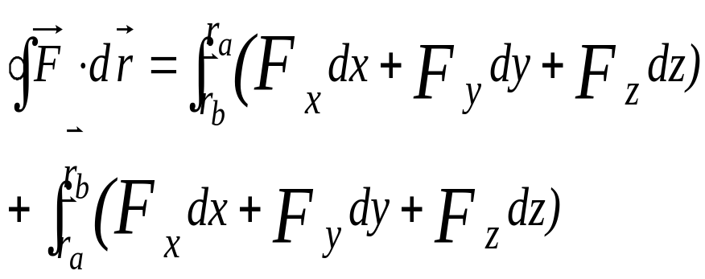
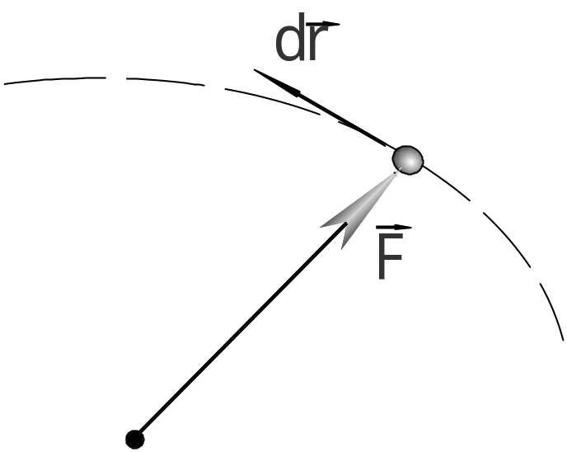
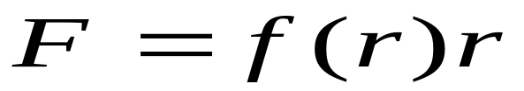
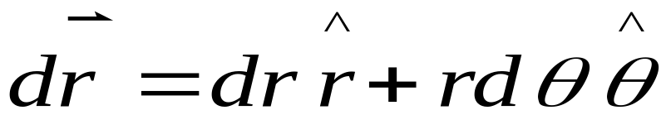
(I)
(II)
= 0
(2).Work done by a central force.
Polar coordinate (for simplicity):

Slide 6
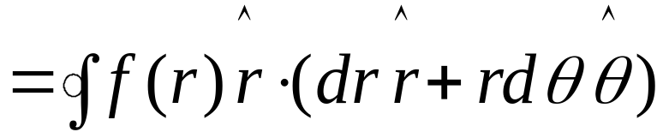
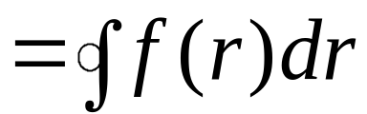
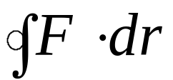
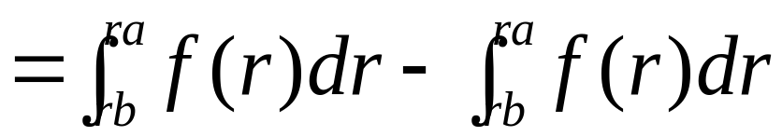

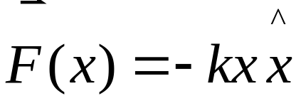
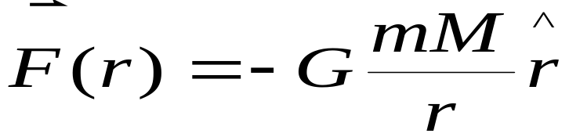
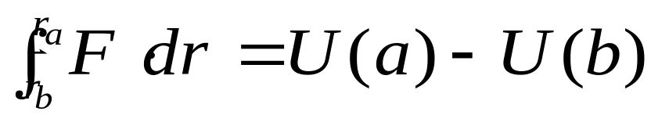
(I)
(II)
Independent of path:
Elastic force:
Gravitational force:
Only depends on
“ position”!


Slide 7
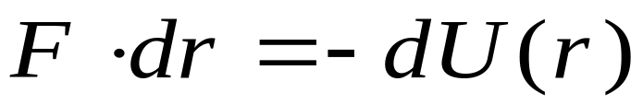

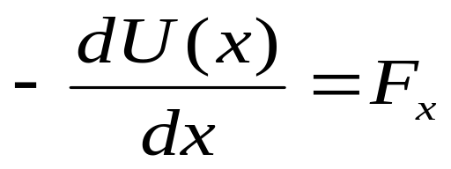
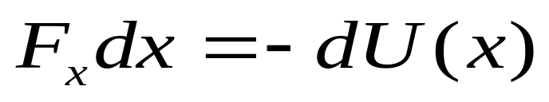
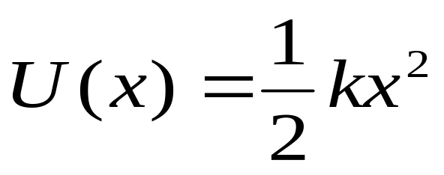
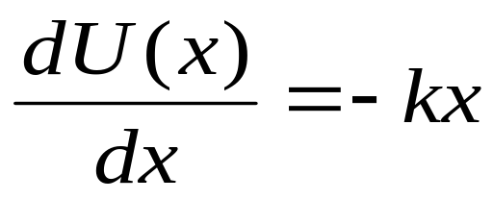


⇒
How about Coriolis force?
<imply the origin of inertia?>
Introduce a function of position:
1-D:
not unique.
Give U(x): F=?
“O” point: x=0, =0.

Slide 8
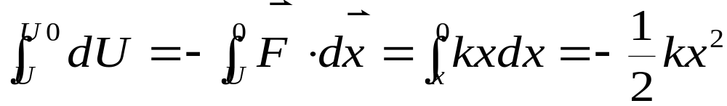
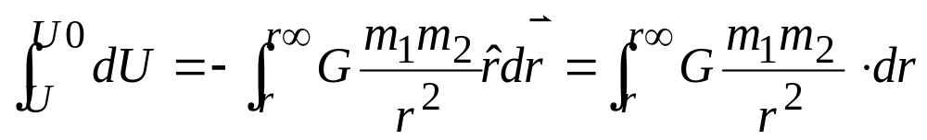
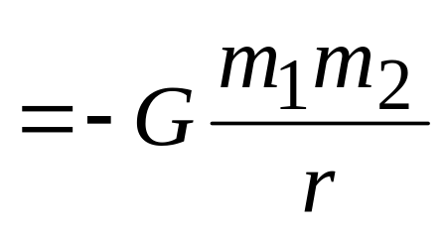
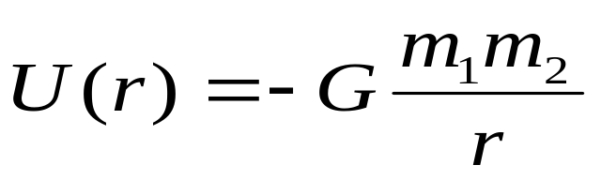
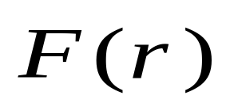
Gravitational force:
⇒
In modern Physics
(field) is replaced by U(r).
U(r)
describe a field.

Slide 9
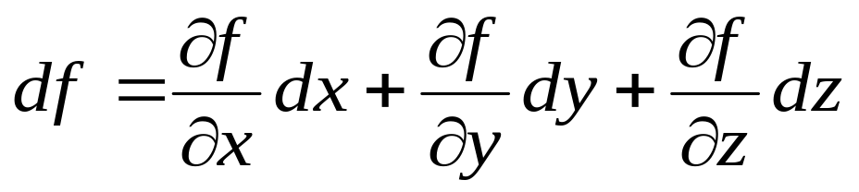
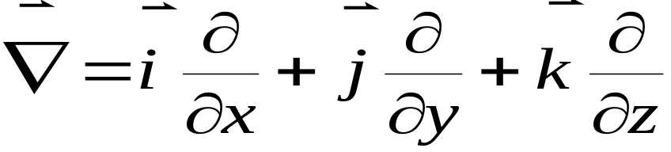
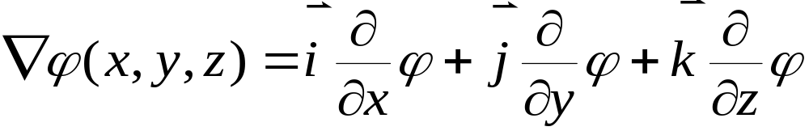
Advanced Remarks:
(1).Partial derivative f(x,y,z)
(2).
(3).
Gradient of Φ:

Slide 10
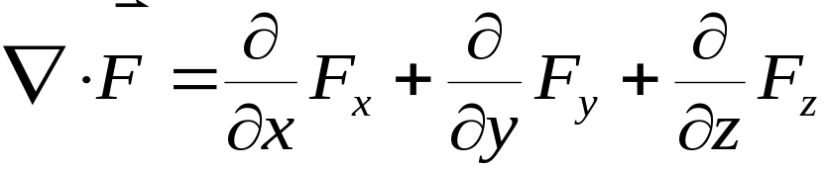
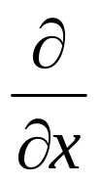
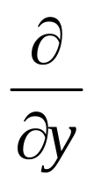
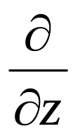

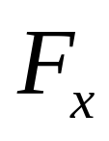
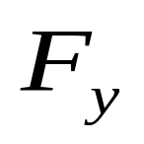




Divergence of F:
i j k
Curl of F:
(4).
Curl-less force


Slide 11




There exists :

Follow your passion then money will come.
Energy:
Universal quantity. But there is no exact definition.
Mechanical energy
Electronic energy
Big family
Thermal energy
Atomic energy

Slide 12




Feynman story about the conservation law of energy .
2-2 Law of conservation of mechanical energy
Particle:
System:
Conservative force =0
Work done by non-conservative force=0
Dissipative force=0
Definition:depend on the frame
Heat individually
Time inversion:invertible process

Slide 13


Conservative System:
Energy can neither be created or destroyed,
only convert from one form to another.


Slide 14








§3.Potential Energy Carve
Conservative force F(x)
potential
Example:
Central force:

Slide 15





1-D:
U(x)~x:
Example:
Spring and block
Oscillator (harmonic motion. point of stable equilibrum)

Slide 16




Molecular force:

Slide 17



Pendulum:
(1).
Point of
inflection .

Pendulum:
(2).
Symmetry broken

Slide 18





§4. Dynamics of a System of particles
4-1 Center of mass

Definition:
Remember:
Pendulum:
Connecting F and P.

Continual system:
Sum integral

Slide 19







In Cartesian coordinate:
Remarks:
(1).Center of mass may be out of body.
(2).In uniform symmetrical system,
is at the
symmetrical axis.
(3).

Slide 20



Example:
Find out the center of mass.
(1). Uniform

Slide 21








(2).Examples for center of mass
 , similar to .
Pendulum:

Slide 22





Practice your mind by this chance.
(a).
(b).

Slide 23




(c).
Cone

Slide 24




(d).

Slide 25









(e).
(f).


Slide 26








(g).
Practice
When if
?
(h).
semi-sphere

Slide 27







⇒

Slide 28






(i).
Cut-and-paste
§ 4-2 Center-of –mass Frame

Slide 29




If we take a frame in which
Then it will be called “Center-of-mass frame”.

Slide 30




Example:
(1).
Person walk relatively to the boat.
What about the boat?

Slide 31











(2). Solution 1:
Density:

Slide 32










Slide 33






Solution 2:

Slide 34









,
,
Others:
a.
b.

Slide 35





c.
d.
Center-of-mass Frame:
Non-inertial frame

,
Inertial frame
Kinetic energy:

Slide 36












Slide 37






4-3 collision
Interaction: 0.
Perfect elastic collision
Fundamental particles
Perfect inelastic collision
:
(1).
(2).

Slide 38







(3).
⇒
Collision parameter and scattering
cross-section.
How to “see”:

Slide 39




Problem3-9:
(1).The max acceleration of the center-of-mass of
system consisted A and B.
(2).The max of Center-of-mass.
Solution:
(1).

Slide 40













On the other hand
When lefts from the wall =0, =0.
(2).

when
( left from
the well),
and
gets the maximum.

Slide 41




But is wrong!
Problem 3-29:
Solution 1:

Slide 42










Slide 43





Solution 2:

Slide 44







Slide 45







Problem 3-6:

Slide 46










For example:

Slide 47



